Slide 1
Closed Orbit Distortions
Eric Prebys, UC Davis

Slide 2
Closed Orbit Distortion
We have considered the effect of a small quadrupole perturbation
We will now discuss effect of a small dipole perturbation, which is generally referred to as a closed orbit distortion
Note that a misaligned quadrupole has the same effect as the addition of a small dipole term.

Slide 3
Closed Orbit Distortion (“cusp”)
We place a dipole at one point in a ring which bends the beam by an amount Θ.
The new equilibrium orbit will be defined by a trajectory which goes once around the ring, through the dipole, and then returns to its exact initial conditions. That is
Recall that we can express the transfer matrix for a complete revolution as

Slide 4
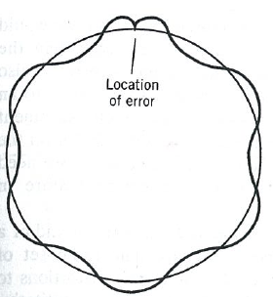
Plug this back in
We now propagate this around the ring

Slide 5
Local Correction
Recall our generic transfer matrix
If we use a dipole to introduce a small bend Θ at one point, it will in general propagate as
Remember this one forever

Slide 6
“Three Bump”
Consider a particle going down a beam line. By using a combination of three magnets, we can localize the beam motion to one area of the line
We require
Local Bumps are an extremely powerful tool in beam tuning!!
Cancel out angle from first two bends

Slide 7
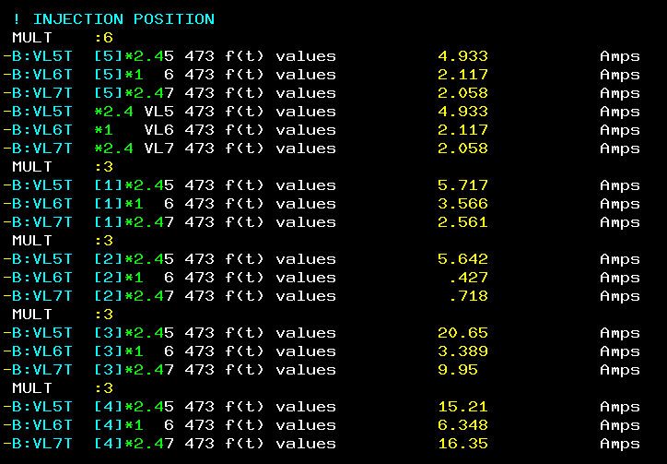
Controls Example
From Fermilab “Acnet” control system
The B:xxxx labels indicate individual trim magnet power supplies in the Fermilab Booster
Defining a “MULT: N” will group the N following magnet power supplies
Placing the mouse over them and turning a knob on the control panel will increment the individual currents according to the ratios shown in green

